Slide 1


DISTRIBUTED CROWDFUNDING SYSTEM USING BLOCKCHAIN
PANIMALAR ENGINEERING COLLEGE
DEPARTMENT OF COMPUTER SCIENCE AND ENGINEERING
CS8811 PROJECT WORK
REVIEW NO:2
Guide Name: Dr. N.Pughazendi
Team Members : SRIRAM S(211418104269) SRIRAM S(211418104268) PRABAKAR(211418104191) Batch No: C7

Slide 2
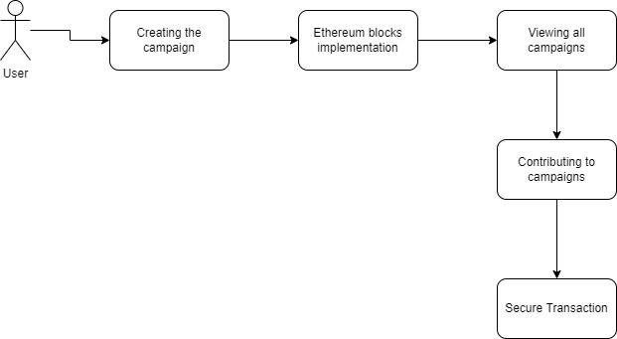
System Architecture

Slide 3
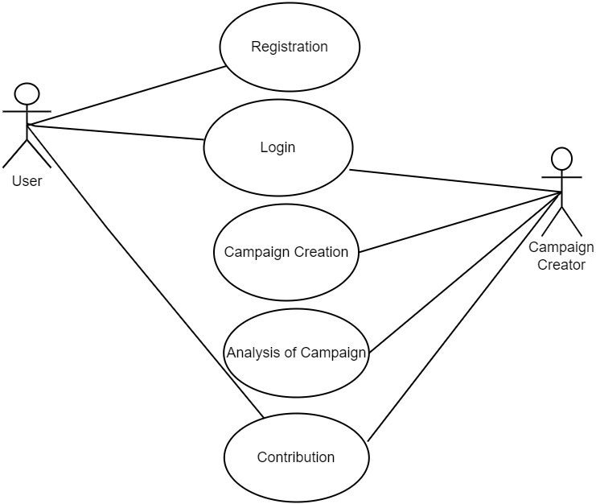
Use Case Diagram

Slide 4
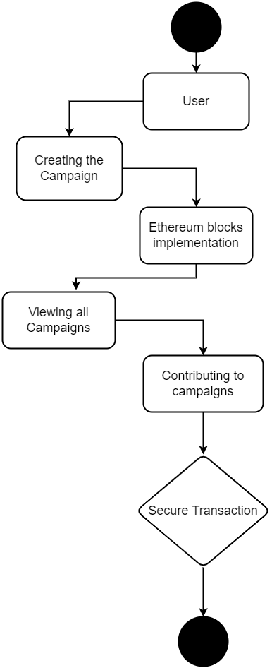
Activity Diagram

Slide 5
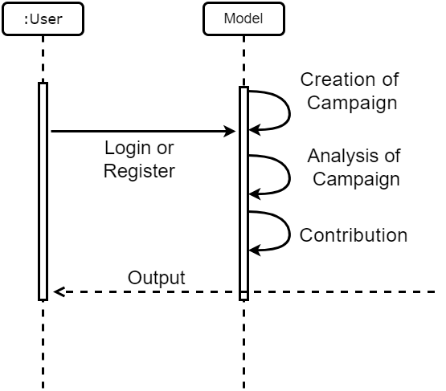
Sequence Diagram

Slide 6
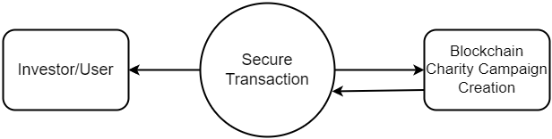
DFD (Level 0)

Slide 7

DFD (Level 1)

Slide 8
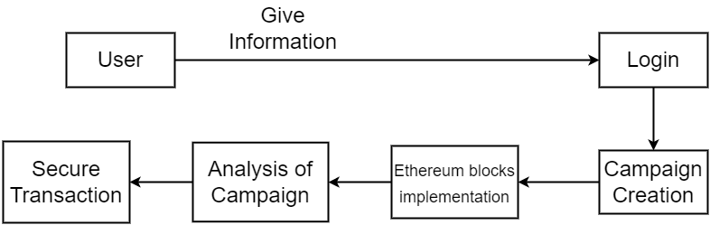
Collaboration Diagram

Slide 9
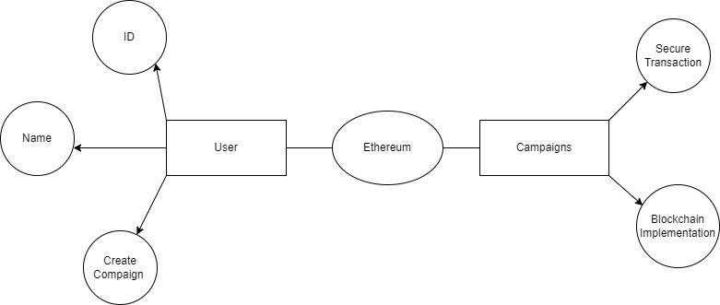
ER Diagram

Slide 10
Module Description
Process Model
Campaign creation
Analysis of campaign
Contribution

Slide 11
Module Description
Campaign creation
In the first stage a project manager creates new project by mentioning the name of the project, the description of the project and the minimum contribution to that project.
And the contributors then can view the all the open projects in fundraising and charity platform and can choose any project for which they want to contribute.
To mark themselves as contributors, they have to invest minimum contribution for that project which project manager has mentioned while creating the project.
And this money is added to the wallet which can be used by the project mangers.

Slide 12
Module Description
Analysis of campaign
In this stage, if a project manager wants to spend the money contributed by investors, then they have to create the spending request by giving the description about where they are going to spend the money, the total amount they are going to spend and the address of the vendor who will supply the things required by the project manager.
For creating a campaign, a campaign name, campaign creator’s name, single line description, detailed description, a banner image and a campaign video is required.
Then he has to decide how many tokens he would like to give away and the price, name and symbol of each token.
He also needs to give his Ethereum wallet address to receive the funds once his campaign is successful.

Slide 13
Module Description
Contribution
An investor who lands on the fundraising and charity app platform can browse through all the campaigns, search or sort the campaigns based on his interests and invest ether to support 15 his favorite campaign.
The investor needs to have a sufficient amount in his wallet to invest and pay for the transaction (gas) to be mined.
Once the project is successful, he can claim the campaign-specific tokens depending upon the criteria specified by the creator.
If the campaign fails, he can claim his refund of ether that he had invested in that specific campaign.
The campaign-specific token are the incentives for an investor to invest in a campaign that he feels might be successful and the value of the token might increase in future.

